Slide 1
Analysing and theorising from qualitative data
Professor Jacqueline Stevenson

Slide 2
Overview of the session
Frameworks
Philosophies
Method
Analytical positioning
Inductive vs deductive approaches
Analysing Mitch and Janey
Restorying Mitch and Janey
Theorising Mitch and Janey
A few challenges

Slide 3
Frameworks
Theoretical framework: the different theories/theoretical constructs that help explain a phenomenon.
Analytical framework: describes/explains how the analysis will be conducted with a view to identifying meaningful sociological patterns.
Conceptual framework: outlines/describes the different concepts needed to understand the phenomenon.
Paradigm: framework of thoughts or beliefs
Ontology (reality) + epistemology (acquisition of knowledge) – philosophy
Philosophy + methodology (investigative principles) = paradigm

Slide 4
Philosophies
Positivists: there is a single reality, which can be measured and known; research involves hypothesis testing to obtain “objective” truth.
Constructivists/interpretivists: there is no single reality or truth, and therefore reality needs to be interpreted; research is used to obtain an understanding of the word from an individual perspective.
Pragmatists: reality is constantly renegotiated, debated, interpreted; the best method to use is the one that solves the problem
Social realism: draws attention to the everyday conditions of the working class and the poor; researchers are critical of the social structures which maintain these conditions.

Slide 5
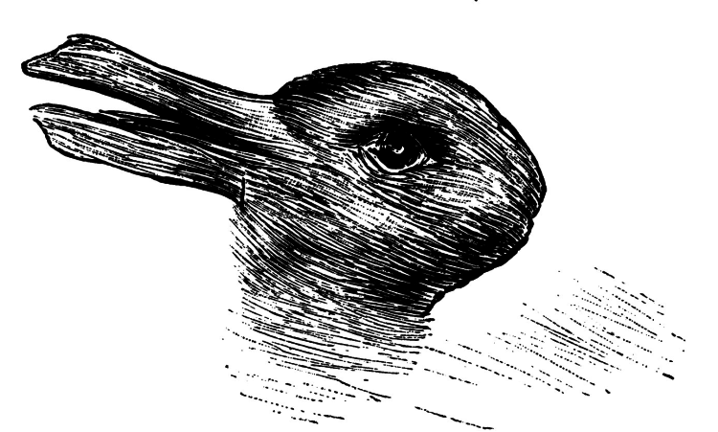
Old or young woman? Duck or bunny?

Slide 6
3 methodological approaches
Narrative research (focuses on the lives of individuals as told through their own stories)
Participatory Action Research (seeks to understand the world by trying to change it, collaboratively and following reflection)
Grounded Theory (construction of theory through the analysis of data)
All three methodologies may use the same method e.g. interviews

Slide 7
Methods
Don’t map easily
Interviews/ discourse analysis etc can be under taken from different stances
Pluralism at the level of method
But impacts on how you analyse
And what you then claim

Slide 8
Why does it matter?
Locates your research in the broader set of debates in the literature
Guides (not determines) the choice of methodology and your analytical framework
Brings a coherence to the knowledge claims you are making for your research, arising from your analysis
And, quite practically, if you are doing a PhD your examiners will want to test out that you are clear

Slide 9
Some thoughts
What is the nature or essence of the phenomena you are investigating?
Is the phenomenon objective in nature or created by the human mind?
What ontological assumptions are you making?
What epistemological assumptions are you making (including language claims)?
How does your position fit in the field - is it the dominant approach?
What does this mean for your approach to analysis?

Slide 10
Analytical positioning
Theoretical framing and research paradigm: shapes questions asked and answers presented.
Methodology informs method: qualitative and/or quantitative data.
Three analytical levels: micro, meso, or macro
Range of approaches: inductive vs deductive

Slide 11
Inductive approaches
Begins with a set of empirical observations.
Seeks patterns in those observations.
Theorises about those patterns e.g. move from data to theory; specific to general.
Cf Grounded Theory

Slide 12
Deductive approaches
Begins with a theory.
Develops “hypotheses” from that theory.
Collects and analyses data to test those hypotheses.

Slide 13
Comparing two data analysis methods
Interview data on stability of blended families
Grounded theory (deductive)
Coding then theorization: success of a blended family depends on the possibility of adopting a role (supporter; mediator; ‘not a parent’)coherent with the internal dynamics of the family and the pressure or support coming from the environment
General Inductive Approach
Themes and sensitizing concepts: blended families are structured around a quest for family identity that requires recognition of legitimacy/alliance between spouses/openness to the children’s feelings/redefinition of roles
Isabelle F. Dufour & Marie-Claude Richard | (2019) Theorizing from secondary qualitative data: A comparison of two data analysis methods, Cogent Education, 6:1, 1690265, DOI: 10.1080/2331186X.2019.1690265

Slide 14
Analysing Mitch and Janey

Slide 15
Discuss
How did you analyse the transcript?
What assumptions did you make?
What did you add in/leave out and why?
What were the key themes?
What are the themes that link them?
Discuss your vignettes

Slide 16
Narrative: an analytical exemplar

Slide 17
What is narrative research?
A story is a ‘first-person oral telling or retelling of events related to the personal or social experiences of an individual’ (Ollerenshaw and Creswell 2002, p.332); only in the transformation of data does story becomes narrative
In narrative research, inquirers describe the lives of individuals, collect and tell stories about people's lives, and write narratives of individual experiences
Narrative typically focuses on studying a single person, gathering data through the collection of stories, reporting individual experiences, and presenting the meaning of those experiences for the individual.

Slide 18
Narrative Inquiry
NI the ‘data emerges from the relationship between the teller, the listener and the context of the telling of the story’ (Riley and Hawe 2005, p.227); i.e stories only become narratives when the data is not only analysed but also interpreted or re-storied
Narrative Stories have a beginning, middle, and end; time, place, plot, and scene
May involve a predicament, conflict, or struggle; a protagonist or character; and a sequence with implied causality (a plot) during which the predicament is resolved in some fashion

Slide 19
Steps in narrative research (Cresswell)
Build in past,
present, future
Build in place
or setting
Describe their
story
Analyze story
for
themes
Have them
tell story
Collect other
field texts
Restory or re-tell
the individual’s
story
3
Collect stories from the
individual that
reflect personal experience
Collaborate with
participant storyteller in
all phases of research
5
4
2
Write a story about the
participant’s personal
and social experiences
6
Purposefully select an
individual to learn
about the phenomenon
1
Identify a phenomenon
that focuses on/addresses
an educational problem
‘Validate’ the accuracy of
the report
7

Slide 20
Key characteristics: Restorying
Researcher records, transcribes and codes then:
Gathers stories and analyses them for elements of the story
Rewrites the story to place it in a chronological sequence
Builds in context and themes
Restorying provides a causal link among ideas

Slide 21
Restorying Mitch and Janey
Beginning
Middle
End
Time
Place
Plot
Scene
Predicament/conflict

Slide 22
Thinking theoretically
Possible Selves
Bourdieu
Theorising Mitch and Janey

Slide 23
And finally….
Methodological challenges of narrative
issues of validity, generalisability, trustworthiness - ‘fiction’, ‘untruth’, ‘untrustworthiness’ and ‘lack of rigour’
Subjectivity: interaction between researcher/participant; need to develop requisite trust, empathy and rapport to facilitate the telling of the story
Representation: whether the researcher can ever directly capture and present ‘lived experience’
Jack in Two Boxes

