Slide 1
Using Research to Inform Policy
Care Leavers in Higher Education: A Case Study
Dr Katie Ellis
Twitter: @DrKatieEllis
Email: k.ellis@sheffield.ac.uk

Slide 2
The context: care leavers in Higher Education
Around 80,000 children are in care in England
Disrupted educational journeys can mean poorer educational outcomes
Care leavers are overrepresented in negative statistics around issues like mental health, drug addiction and homelessness
In 2018, the percentage of children in care who received at least a pass in GCSE English and Maths was 17.5%
Approximately 12% attend university

Slide 3
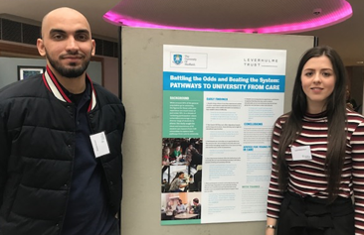
Our research
Steering group of 3 care experienced students
Interviews with 42 care experienced students from four universities
192 online responses from care experienced students in 29 universities
In total 234 care experienced students shared their perspectives

Slide 4
Findings: Arriving at university
Over a quarter arrived at university on their own:
I got a bus, all the way … that took twelve hours … I had a cry, because everyone was with their parents and it was really like overwhelming (Dawn)
Moving in was challenging and highlighted differences from peers:
It was just disappointing. I’d looked forward to moving to uni and I didn’t have anything to move in, didn’t have anything to unpack, didn’t have anything to put up on the walls, didn’t have a TV to watch. I didn’t even have food at the time (Craig)

Slide 5
Findings: Fitting in
Several participants struggled to manage
financially during their transition to university and missed out on early opportunities to develop friendships with other students:
I didn’t have the money to go out … I just made up things sometimes ‘oh I can't be bothered, I’ll just stay in my room’ and stuff (Craig)

Slide 6
Findings: University support
For those without a specific ‘care leaver contact’
the university felt large and faceless:
If I did need money for funding or something, like, I wouldn't know how to do it, I've no idea (Jess)
Many were unclear about the support that they were entitled to:
They’ve offered me a ‘Care Leaver Package’ … I ain't got a clue what it’s really about, ‘Care Leaver Package’, what’s included? (Marcus)

Slide 7
Getting the message across: Policy report & recommendations

Slide 8
Sharing findings and creating change: Video

Slide 9
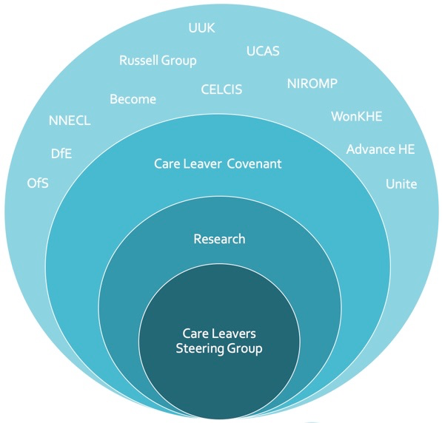
Influencing policy: identifying the key stakeholders
Infographic from Westminster policy forum
How to influence key players, CLC helped to push
Wider stakeholders
Influential policy contact
Care Leavers

Slide 10
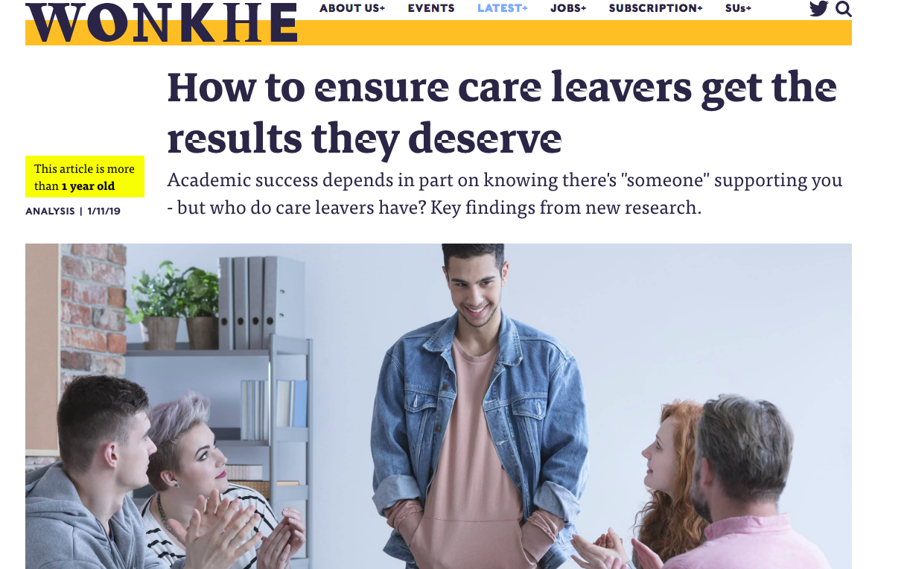
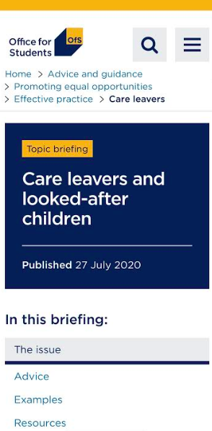
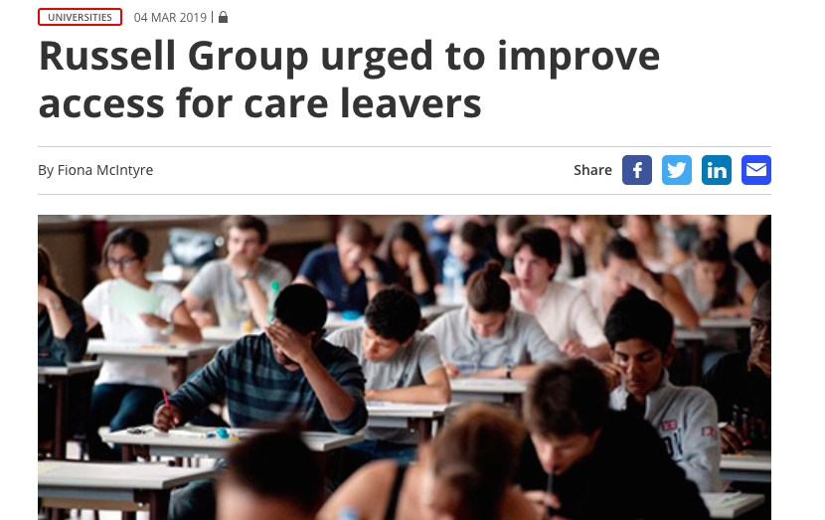
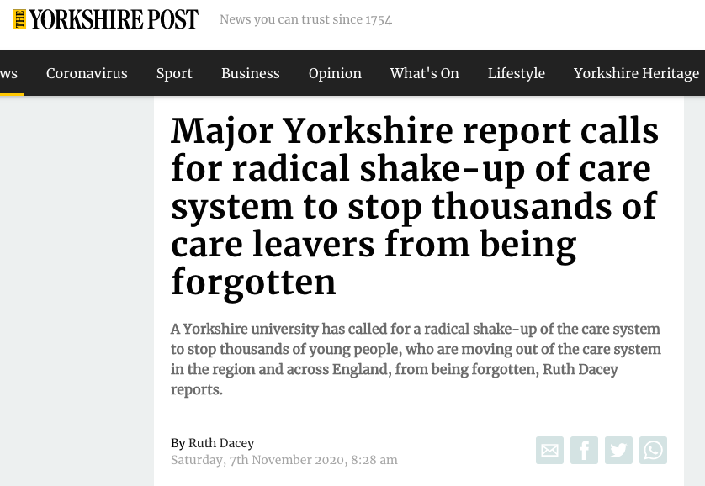
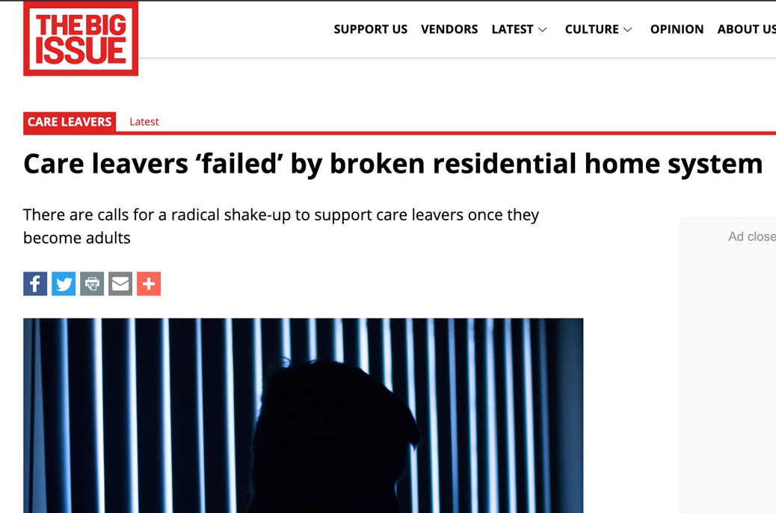
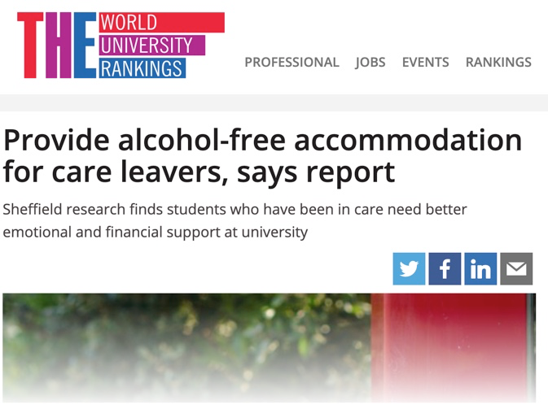
Getting the message across: media

Slide 11
Working with stakeholders to promote policy change:
Impact examples
Hosted by the Office for Students as ‘Guidance for Universities’
72 Universities have signed up to the Care Leaver Covenant
NNECL to create a Gold Standard for Universities
Endorsed by the Russell Group as best practice
Shared by NAVSH to virtual school heads

