Slide 1
Translating the Value of Qualitative Longitudinal Research across Disciplines SSP seminar: ‘In Conversation’ with Jonas Masdonati Qualitative Longitudinal Research: Strengths and Challenges Bren Neale School of Sociology and Social Policy March 2024

Slide 2
Outline Introducing Qualitative Longitudinal Research (QLR): A fluid world; The processual ‘turn’ Four key features Challenges (and how to overcome them): Cost/sample attrition/data deluge Longitudinal Ethics/Complex Analysis Lacks precision/closure Strengths: Offers unique insights into the complexities of causal processes and the ‘how’ of change

Slide 3
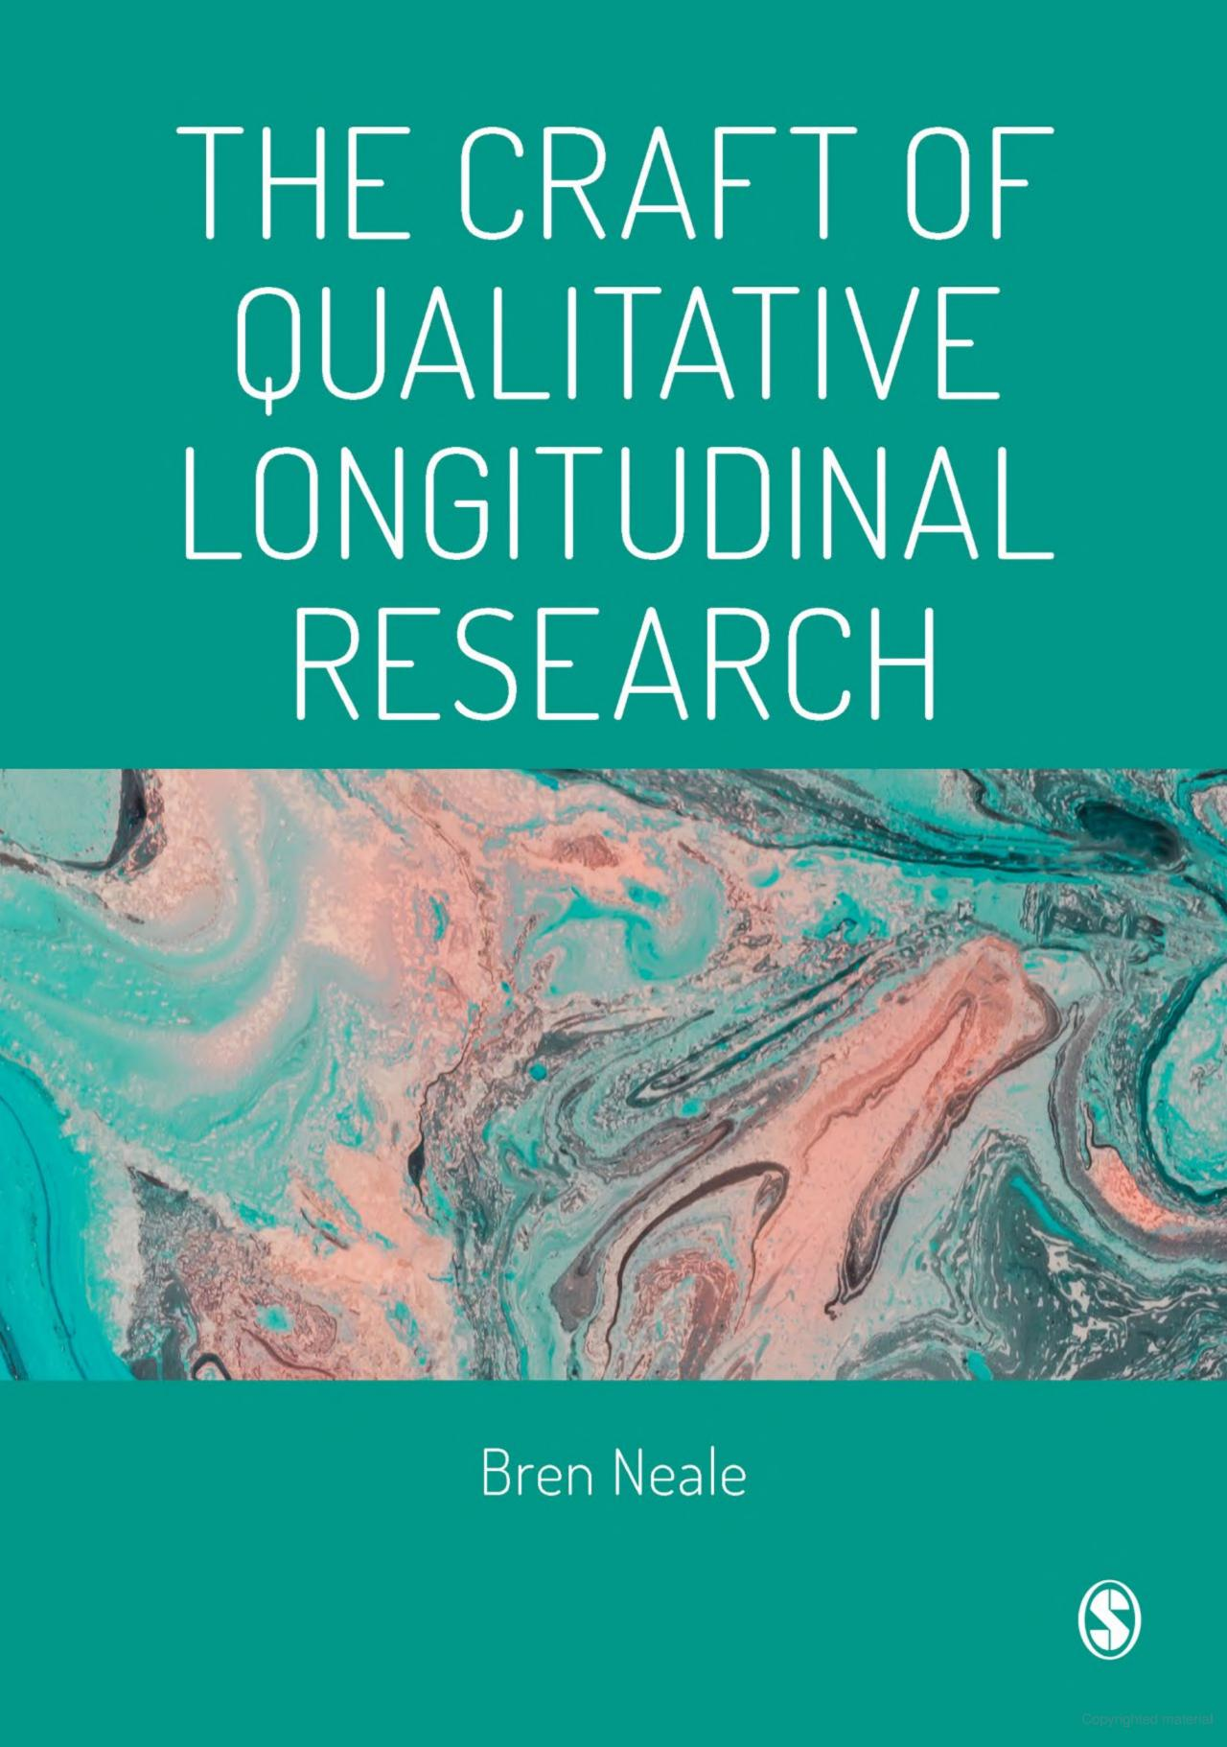
Neale Sage: 2021

Slide 4
A Fluid World
Ideas about the fluid nature of existence have a long pedigree, stretching back to the days of Heraclitus (530-470 BC). Heraclitus observed that an individual cannot step in the same river twice, for both the individual and the river as continually changing:
the river is not an object but an ever-changing flow
The sun is not a thing, but a flaming fire.
The world is shaped through action/interaction continuity/change, evolution/revolution
E P. Thompson (1978: 85): ‘[Class] is not a thing, it is a happening, not this or that part of the machine but the way the machine works once it is set in motion, the friction of interests, … the thundering noise… The definition can only be made in the medium of time’
Throughout the C20th there has been a growing interest in time theory, accompanied by a processual turn among researchers that straddles the academy.

Slide 5
The Processual Turn
Here is Henri Bergson, French philosopher, time theorist and Nobel prize winner, who since the late 1890s has influenced numerous writers, time theorists, philosophers and scientists (Proust, Sartre, Whitehead, Heidegger, Prigogine (thermo-dynamics):
There do not exist things that are made, but only in the making, not states that remain fixed, but only states in process of change. … Rest is apparent or rather relative. … [We]arrive at fluid concepts, capable of following reality in all its windings. (Bergson 1946 [1903]: 188, 190)
Events and processes are … complex because they necessarily exceed our capacity to know them. … [We need to create] metaphors and images for what is … slippery, indistinct, elusive, complex, diffuse, messy … intuitive … The world is not a structure, something we can map with our social science charts. We might think of it instead as a maelstrom or a tide-rip … filled with currents, eddies, flows, vortices, unpredictable changes, storms, and with moments of lull and calm. … We begin to imagine what research methods might be if they were adapted to a world that included and knew itself as tide, flux and general unpredictability.’ (Law After Method 2004: 6-7)
A basic insight: If the social world is fluid, in perpetual flux, we need fluid modes of enquiry to investigate and understand it.

Slide 6
Qualitative Longitudinal Research
A well-established methodology throughout the academy.
Typically, small scale, in-depth, dynamic studies of the unfolding lives of individuals/collectives, seen against a backdrop of historical events/processes (environmental, institutional, technological, policy related). Understanding the relationship between these two facets of the social fabric is vital and it is essentially dynamic:
We cannot hope to understand society unless we have a prior understanding of the relationships between biography and history … and the problems of social structure in which biography and history intersect (C. Wright Mills 1959: 225)
Sociology without history resembles a Hollywood set: great scenes, sometimes brilliantly painted, with nothing and nobody behind them (Charles Tilly 2008: 120)
It is through time that we can begin to grasp the nature of social change and continuity… [and] the mechanisms through which these processes unfold. … Indeed, it is only through time that we can gain an understanding of how agency and structure, biography and history, the micro and macro dimensions of society are interconnected and how they come to be transformed (Neale 2015).

Slide 7
1. Real-time research
As an integral part of the longitudinal canon, QLR seeks to follow the same individuals/groups prospectively through time, to capture change in the making. It turns a snap-shot of the social world into a ‘movie’ (Leisering & Walker).
Designs are flexible but at least two waves of fieldwork are needed to generate rich, situated data with longitudinal reach. Studies may be conducted intensively, over the short term, with frequent field visits, and/or extensively over decades.
Has been described as walking alongside people, looking forwards and backwards in time to give a detailed processual understanding. QL researchers are like time travellers, combining prospective and retrospective lenses.

Slide 8
2. Up-Close qualitative research
Located within the interpretivist tradition(with strong affinities to longitudinal ethnography, biographical, life history and narrative research). QLR engages with and seeks to mirror real-world processes through an in-depth qualitative lens. This gives insights into how people narrate, understand, practice and shape their evolving lives and the evolving world of which they are a part. This approach takes human agency and subjectivity seriously: the up-close-and-personal movie, with enhanced depth and explanatory power.
Ethnography, life journey/biographical interviewing and participatory methods are commonly combined to gain insights into the inner logic of people’s lives - how change is created, negotiated, lived, experienced.

Slide 9
3. Fluid Enquiry: A Kaleidoscope of Temporal Flows

Slide 10
3. Fluid enquiry
QLR is driven by a complex fluid ontology that takes us beyond a linear understanding of time – ‘what happens next’ – while this is a useful starting point, we know that lives don’t necessarily unfold in chronological order, through discrete stages, in one linear direction or at a uniform pace.
Processes may be unpredictable. Lives are shaped by multiple contingent events, actions, interactions, flowing at different speeds, in all directions, through different horizons of time (past to future, short term to longer term) and at different scales of the social fabric – we need a more complex and nuanced understanding of the flux of change.
Past-Present-Future intersect in complex ways. We are forever coming to a new vantage point from which to overwrite our biographies, to look back and reinterpret the past, and to look forward to re- envisage the future. This is recursion, when time seems to loop back on itself. In the process we gain insights into changing perceptions, not just changing events, recognise that our identities are in flux.

Slide 11
When you look back, you see the path or paths that you've taken. The path would obviously not be so clear when you're groping up and finding it, would it? I mean it's rather like going up a mountain, you're sort of looking that way and that track, and it looks too steep and you're going round … Whereas when you're high up you can look back and see, and it sort of stands out much more clearly, things you didn't realize at the time
(Molly Andrews ‘Never the last word’, in Andrews et al Doing Narrative Research Sage 2008)

Slide 12
Past-Present-Future
… life … must be lived forwards. … But … it must be understood backwards.
Sǿren Kierkegaard
19th Danish philosopher

Slide 13
Life Map:Guenette & Marshall 2009

Slide 14
Causal complexity
Causal processes are not simply a matter of A leads to B. They are necessarily complex, requiring an understanding of their multiple, fluid and relational elements. We might explore:
The pace/speed/tempo of change (the elasticity of time)
Short term or longer-term time horizons (how time telescopes)
How/why do things stand still, stagnate, slow down, speed up, rewind? How does change emerge, evolve, grow, stabilise and recede?
Is it sudden (revolution) or slow burn and hidden (evolution)? What leads to a tipping point - a point of no return in the social or environmental fabric or in the course of our lives?
We need a focus on the nature of the journey, not just the destination, the process, not just the outcome, the how of change, not just what changes.

Slide 15
Policy Implications
Has particular value wherever people are encouraged/ required/seeking to change their lives or adapt to changing circumstances.
If we can understand people’s fluid transitions into and out of poverty or prison, employment or education, health or housing, migration or mobility, or their journeys through ageing/ pandemics/recessions/political and environmental upheavals, then we can create useful know-how knowledge that will help policy to better manage these processes and support people through them.
QLR can address some of the grand challenges of social science in a world of rapid social change; can act as a navigational tool to investigate the effectiveness of policy interventions or the impact of historical processes.

Slide 16
4. A fluid methodology
QLR not only engages with fluid processes; the way a study is designed and conducted, from sampling to data generation and analysis is fluid. It responds flexibly to the processes under study and becomes part of the moving picture.
It is responsive/interactive/adaptable - attuned to the flux of the world.
Each wave of fieldwork and analysis informs the next in a cumulative process of knowledge building – as Bergson says, following reality in all its windings.
This requires flexibility in research design and conduct so that researchers can follow lives where they lead.
E.g. Lynn Calman et al (2013) followed a sample of terminally ill cancer patients to explore the progression of the disease. But the rigid design meant that many patients died before the next visit. They observed that a more flexible schedule of fieldwork would have enabled them to follow the full sample, responding to and mirroring how the disease was progressing in each case.

Slide 17
Example of a QL process evaluation
A Scottish government-funded health study of the journeys of people with severe lung disease (COPD) (Pinnock et al 2011). Aim: to find better ways to support people with this slow progressive illness, whose needs are often neglected. Interviews with patients/carers; followed 21 patients intensively over 18 months (11 died during this time).
There were no clear markers for the stages of the illness, its progression, no clear beginnings, no anticipated endings. Patients/ professional carers produced chaos narratives: incoherent stories involving a loss of self.
These fluid/ill-defined illness journeys were at odds with the rigid, linear models of support laid down in clinical protocols. These focused on finding a clear point to introduce palliative care, when no such point exists. Services were often too late to offer support
Solutions? A much earlier, phased introduction of supportive care, offering individualised, responsive support, tailored to how the illness progresses in each case, leading seamlessly to palliative care. Creates a closer alignment between lived experience and policy process. Hugely successful and effective study.

Slide 18
Challenges
Expense: requires more resources than single visit studies (although cost effective within the longitudinal canon).
Sample Maintenance requires ongoing effort – more a matter of sustaining relationships over many years.
Longitudinal Ethics: unique challenges, including a commitment to reciprocity, maintaining professional boundaries, bringing ethical closure to a study.
Data deluge. QLR yields ‘oceans’ of data (Saldana 2003) that may lead to ‘death by data asphyxiation’ (Pettigrew 1995: 111). It requires good data management and careful design, so that researchers/participants are not overloaded with relentless waves of fieldwork but have time for rest/reflection/analysis between waves.
Analytically complex: Switching the temporal gaze between different horizons of time, and working in three dimensions (bringing cases, themes and processes into alignment) is intellectually demanding and time consuming. Accounts of process tracing, mapping and analysis are sparse (Beach and Pedersen, 2019, Bennett, 2010; Valsiner 2009, Neale, 2021).
Takes too long to be of use to policy … but creates impact as part of the research process.
An extensive body of literature to guide us through these pitfalls.

Slide 19
Flexibility … or Continuity
That QLR is flexible and creative is generally regarded as a strength (e.g. Audulv et al 2023; Keskinen and Nikander, 2023) but a QL study can unravel if it lacks continuity and precision – a design issue
Imagine you’re describing a road trip you took across Arizona, a trip where your journey was determined by careful planning (‘After spending two days at the Grand Canyon, I was going to drive to Flagstaff’); unexpected opportunities (‘But I discovered there was to be a pow wow in Chinle, so I drove there instead’); uncontrollable forces (‘The heavy snow fall closed the highway and delayed me’); detours (‘ I took a state road instead of the highway because of construction, and drove to Jerome’); and revised plans (‘When I saw the Red Mountains of Sedona, I just had to drive off the Interstate for a closer look’). Such is the researcher’s journey through a longitudinal qualitative study. (Saldaña 2003: 15)
Criticisms are rare, but Hermanowitz (2016) and McCoy (2017) suggest that the method lacks clear definition, experimental trustworthiness, or any grounding in established methodological traditions. A problem of documentation and lack of awareness of the methodological literature

Slide 20
Balancing Acts
We need to balance flexibility with continuity and creativity with precision in the way that studies are designed, samples drawn, timeframes and tempos specified, and data generated and analysed.
E.g. in generating data we need:
Continuity questions about key themes and processes, that are built in at each wave. These provide ‘through lines’ (Saldana) in the data to ensure a growing dataset has some integrity/internal coherence and allows for comparisons and connections across the waves of data.
Flexible questions, generated afresh at each wave that allow the researcher to formulate new lines of enquiry that are in tune with evolving lives, that can follow lives where they lead.
The fact that QLR is exploratory, creative, flexible and adaptable is a strength: it derives its rigour from its capacity to mirror the flux of the world, to reflect real world processes, in real time and up-close
‘Understanding moves with the flow of the process; it must flow with it’ (Frank Herbert, Dune 1965)

Slide 21
Conceptual Road Map (housing young parents: Neale/Ladlow)
Research Questions | Sub-questions | Sources of Data: Samples and field methods | Fieldwork themes
Lived Experiences: How and why do young people become parents at a young age? How do they manage this transition and its aftermath? How does housing provision impact on young parents? What factors shape their housing pathways, and how are these pathways negotiated and experienced? How is ‘home’ understood? What forms of supported housing are available for disadvantaged young parents? How do they experience this support over time? | How do the past experiences and life histories of young parents shape their current lives, future aspirations, and their life chances? How do young parents’ housing journeys evolve over time? What are their aspirations for housing and what opportunities and constraints impact on these aspirations over time? How do the housing trajectories of young parents intersect with their family/relational/ education/ employment/and welfare trajectories? | Pre-existing empirical evidence: Literature review Analysis of related legacy data: Following Young Fathers Study, young father interviews. New empirical evidence: a qualitative longitudinal enquiry carried out with primarily disadvantaged young parents: Life journey interviewing (2 waves); Life mapping participatory tools Participant-observation at local housing support service. | Life histories and journeys: Family background and relationships Childhood experiences, Housing and home, Education and employment Welfare provision/support Parental pathways/ transitions/ practices/opportunities/constraints Time: past, present, future Space and place: constructions of home, community, security, risk Identities & values (e.g. related to gender, class, parenthood, socio-economic and academic background, support and dependency)

Slide 22
Finding closure?
Is QLR too fluid and open ended?
When does a change process begin and end, especially where the unit of analysis is the continuous process in context? When does the fieldworker stop and start collecting data? Does one stop peeling the layers from the onion only when the vapours inhibit all further sight? There are, of course, no simple and absolute answers to such questions. …Pettigrew, 1995: 98)
Observations are never ‘safe’ because they may always be overturned in subsequent waves (Thomson and Holland, 2003: 221)
We can create a temporal logic to a study, through specifying clear baseline and closure points that anchor a study in time and contain it.

Slide 23
Finding analytical closure?
In this fluid complex world, things are always contingent, half finished, unpredictable. We are always in the middle of things, with no clear ending in sight; and there is always layers of truth and more than one story to tell. Related to this, we may not be able to discern why things change or grasp all the factors that shape lives.
Because there are no definitive or universal answers, we have to aim for plausible explanations; and recognise that our findings are valid in the moment of production, but necessarily provisional, partial, subject to revision (Farrall et al, 2014: 75). This isn’t a weakness: it is the hallmark of the fluid world that we inhabit
Leading researchers who work with time and complex processes stress the need for responsible scholarship and for modesty in our interpretations (Cilliers 2005; Elliot, 2005)
Implication: an interpretive framework of understanding should no longer be seen as an optional extra, a mere supplementary approach. In a complex fluid world, it is an essential foundation for responsible scholarship (Neale, 2021)

Slide 24
Summing Up
QL research is a journey that requires stamina, organisation, sustained commitment, funding, often over years.
A powerful tool for investigating the how and why of change, the interior logic of lives, discovering the unimaginable
When we work with fluid time and causal complexity, we have to engage our imaginations, our intuition and our creative thinking
Involves a leap into the unknown, a capacity to see beyond the visible. We may not know where our research will lead, for how long or in what direction. But it is likely to yield compelling insights along the way.
A health warning: seeing things up close through the lens of time ‘changes simply everything’ (Adam 1990).

Slide 25
Neale Sage: 2021

Slide 26
references
Audulv, A. et al. (2023) Time and Change: A typology for presenting research findings in qualitative longitudinal research BMC Medical Research Methodology 23: 284
Beach and Pedersen (2019) Process Tracing Methods, 2nd edn, University of Michigan Press
Bennett, A. (2010) Process Tracing and Causal Inference, in H.Brady and D. Collier (eds) Re-thinking Social Enquiry, Rowman and Littlefield.
Keskinen, K. and Nikander, P. (2023) Researching time and ageism: Application of qualitative longitudinal research to the field, Journal of Applied Gerontology (42 (6): 1335-1344
Valsiner, et al (2009) (eds) Dynamic Process Methodology in the Social and Developmental Sciences, Springer

